Slide 1



Title:
How to create social media platform?
Submitted To:
Dr. Vijay Pratap Raghuvanshi
(Entrepreneurship)
Submitted By:-
Sachin Rajbhar
41221139

Slide 2
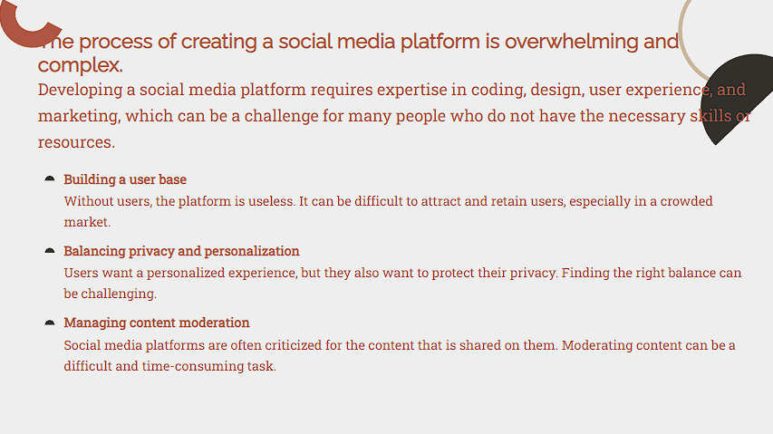

Slide 3
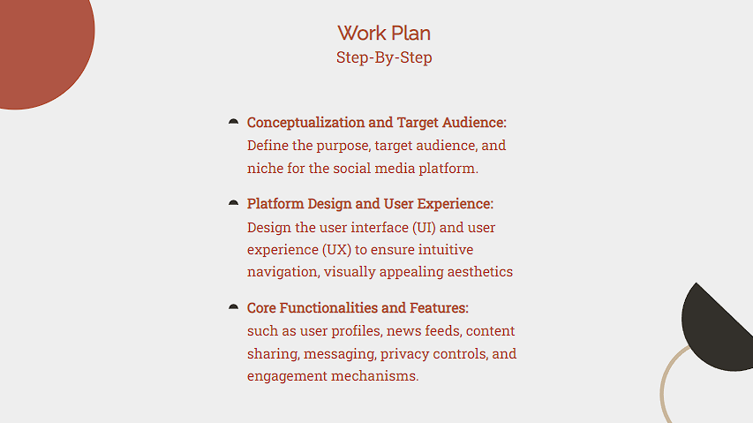

Slide 4
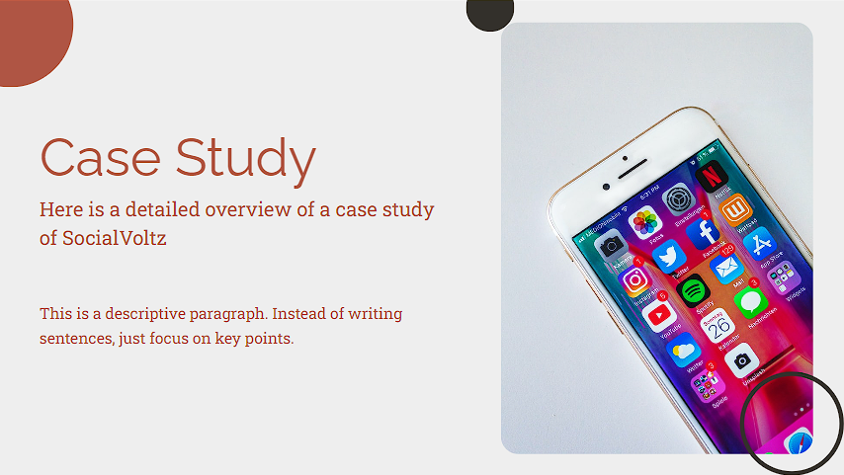

Slide 5


Slide 6
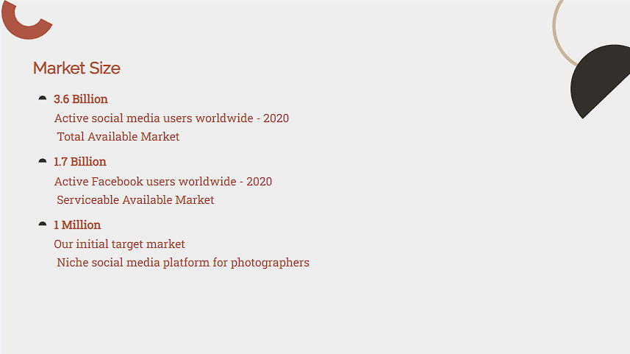


Slide 7


Slide 8
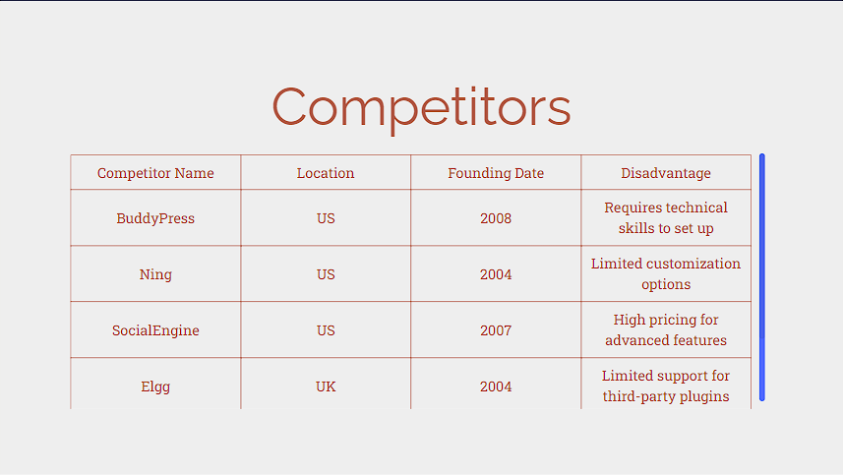

Slide 9
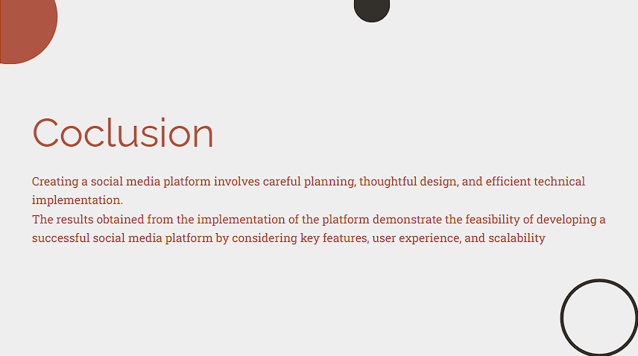

Slide 10
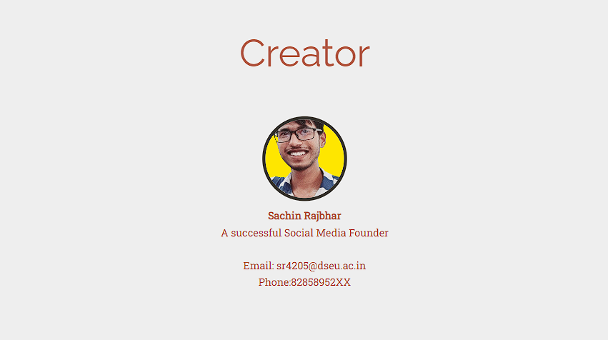

Slide 11


